Slide 1

Grocerwala:- Your one stop grocery store.
Group members:
Shweth Kenkre- 220343120047
Tesjas Shrirao- 220343120107
Akshay Kolhe- 220343120049
Lakshya Pareek- 220343120053
Project Guide – Mrs. Harshita Maheshwari

Slide 2
Contents
Introduction
Choice of topic
Proposed System
Methodology
Proposed System Model
Proposed Approach
Screenshot
System Requirements
Applications
Advantages & Limitations
Conclusion
Future Scopes
References

Slide 3
Introduction
Grocerwala is a web application for customers to buy grocery from local vendor and shop owners.
This site will show you the available options of food and household supplies at the store and allows you to place an order at store at a time
This application provides good communication.
It provides Customers and Vendors Registration and Login.

Slide 4
Choice of Topic
Through this project we can ensure there be less crowd at the stores.
Easy for vendors to manage.
There is product differentiation.
Time saving for the customers.

Slide 5
Proposed System
Aim:
1. It will help the customers spend less time in queues.
2.vendors can easily manage orders.
Proposed System:
1. Digitalized shopping.
2. Communication is transparent.
3. Eliminate Intermediates.

Slide 6
Methodology
The objective is to create a web site that can perform the following:-
Connection to https site through wifi
Opening Relevant HTML pages using Get and Post methods
Read the data into the Database Tables
Create a local database.

Slide 7
Proposed System Model
Home
User Registration
Login
All Items Available
Shopping Cart

Slide 8
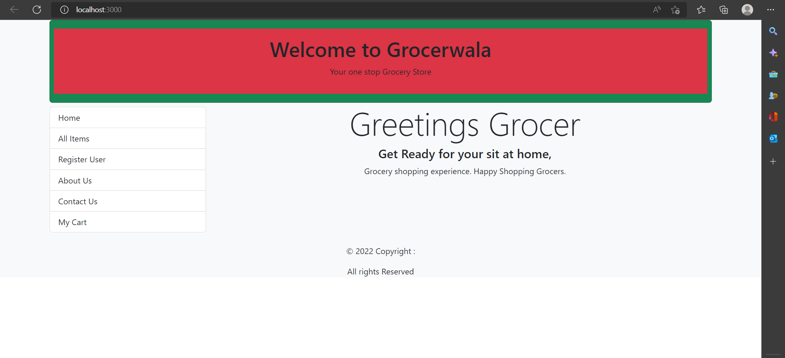

Slide 9
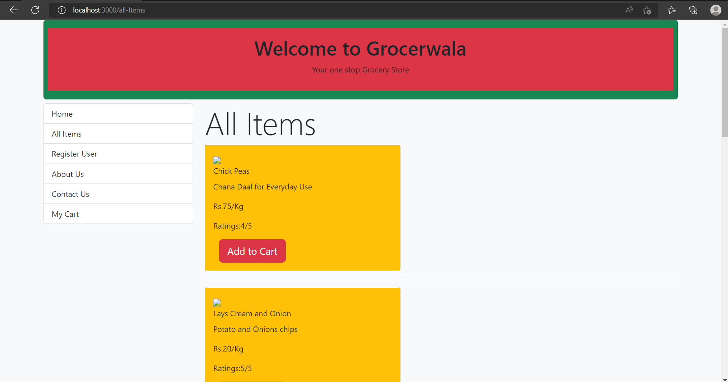

Slide 10
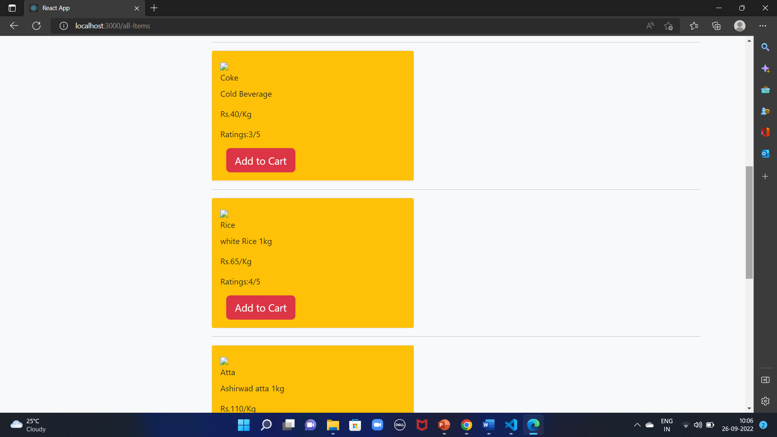

Slide 11
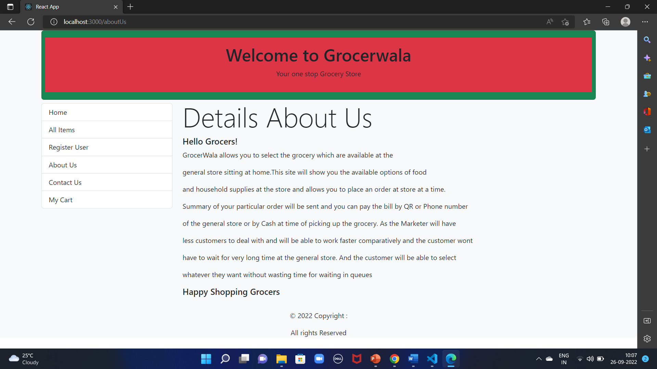

Slide 12
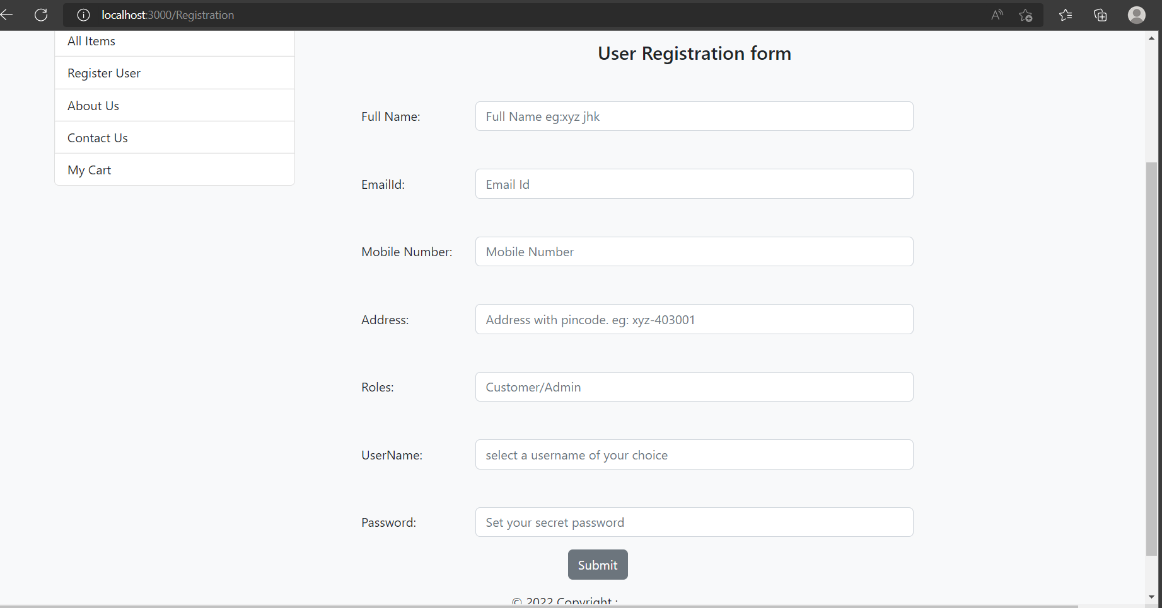

Slide 13
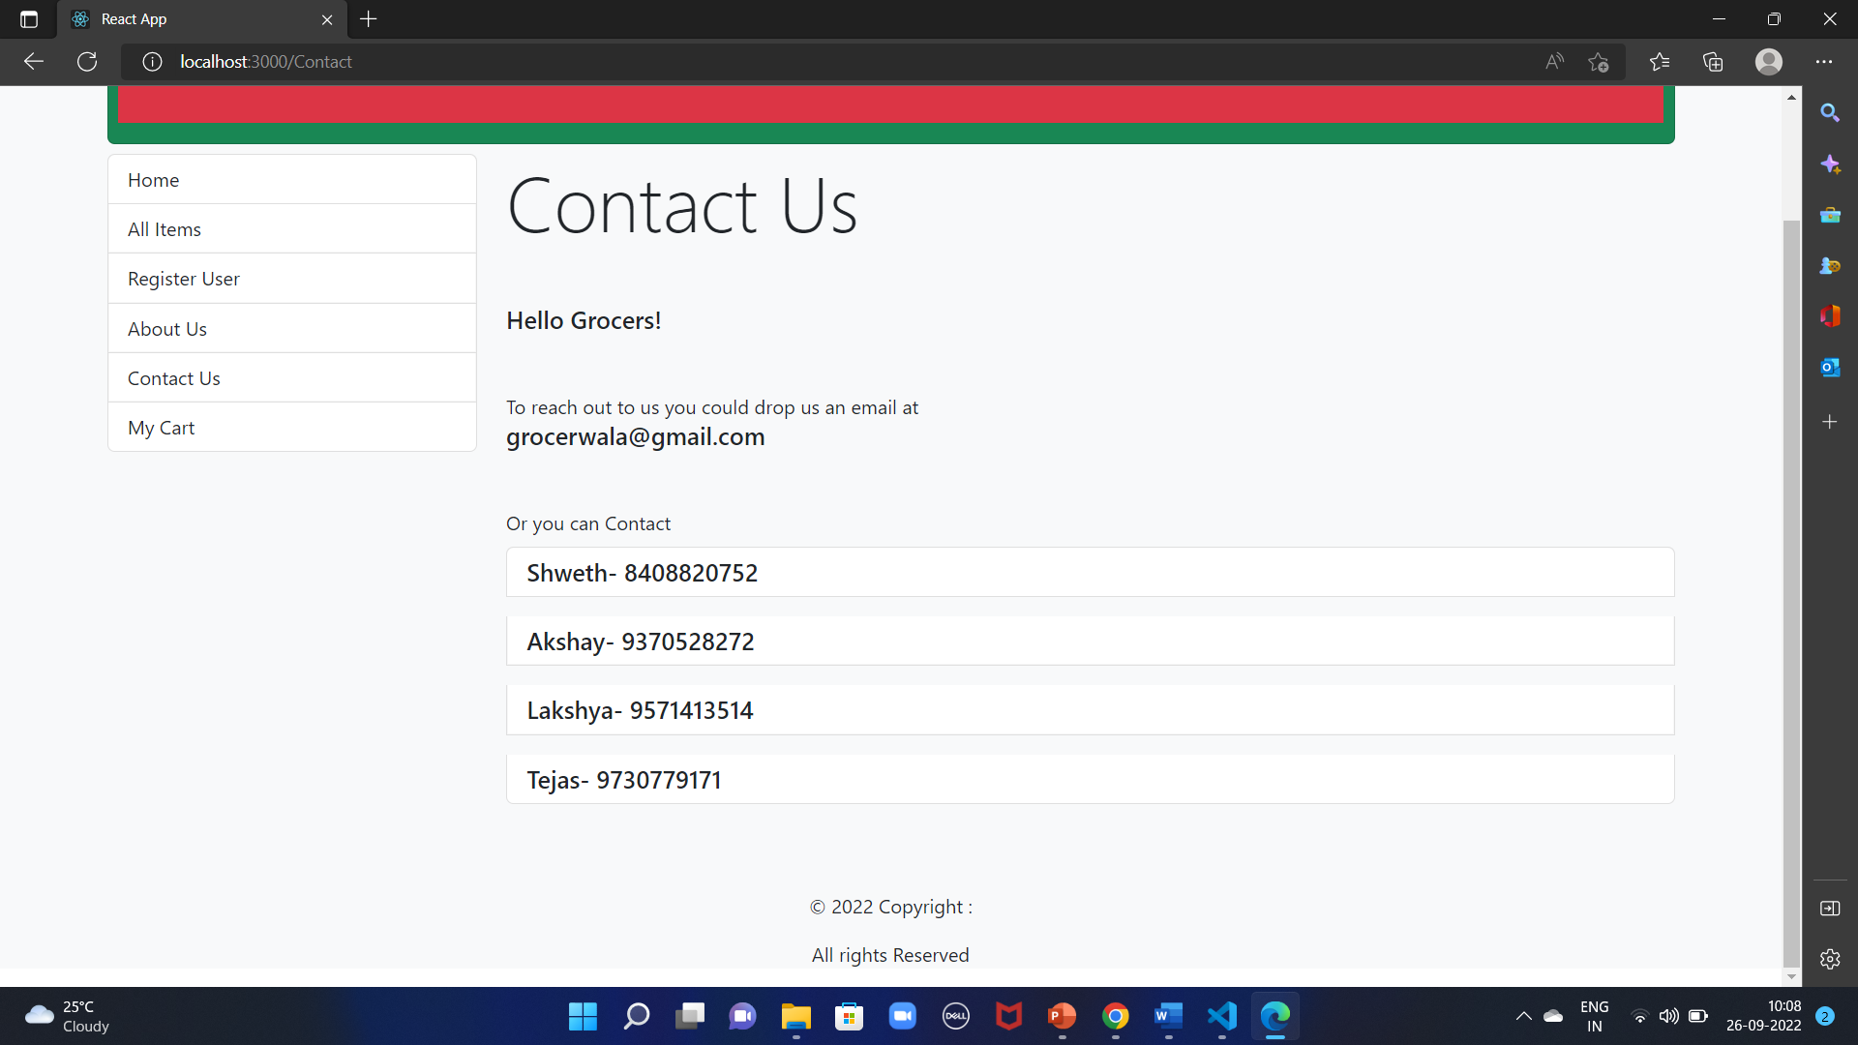

Slide 14
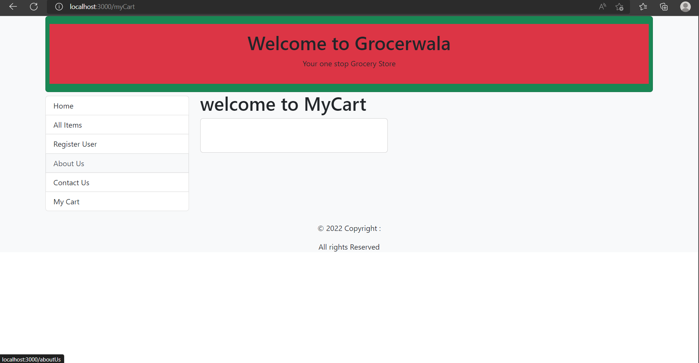

Slide 15
System Requirements
Software Requirements:
Windows(10 and above)
Tomcat 8.5
Eclipse Oxygen , MySql, WorkBench(version 8), Visual Studio Code.
Hardware Requirements:
Processor i3
Hard disk 1Tb
SSD-256Gb

Slide 16
Technologies Used
HTMl
CSS
React JS
Node JS
Spring Boot
Hibernate
MySql
Tomcat
Workbench

Slide 17
Applications
Digital grocery Shopping
Can be Used by anyone having a device and access to internet.
Food and e-commerce Industry

Slide 18
Advantages
There is transparency in the system.
Products sold are at MRP
Need no run from store to store for different items

Slide 19
Limitations
It requires an extensive database and memory.
Too many order could be difficult to manage.
Changes in the database can be made only by the admin

Slide 20
Conclusion
The Grocerwala web service will be designed and developed to overcome the over-crowded shops and vendors to meet the requirement of modern age digitalization. Since many industries are moving towards digitalization the grocery shopping could also be taken a step ahead in the world of digitalization. It will bring transparency between the vendor and the customers and there wont be unnecessary bargaining of price. It will save the time and energy of long queues and grocery hunting for customers. Lastly, it can be improved as per the rising demand

Slide 21
Future Scope
Improvement in design.
User and vendor verification
Net banking/UPI(Unified Payments Interface eg.BharatPe,Google pay) payments
Mobile application
Chat bot.

Slide 22
References
Mr. Saleel Bagde for Database.
Mrs. Harshita Maheshwari for HTML JS & CSS also she was our project guide.
Mrs. Mayuri Fakirpure for SprigBoot and Hibernate ORM
www.youtube.com
A special thanks to Infoway Management who arranged extra lab time for us.

Slide 23
THANK YOU

